Slide 1


What are the factors that make an Airbnb accommodation more attractive?
Group Project
Programming for Data Science
Presented by Rosanna Mueller, Rodrigo Conceição, João Silvestre
and Marc Behse

Slide 2
Index
Motivation
Methodology
General Descriptive Analysis
Geospatial Analysis
Sentiment Analysis
Multivariate Linear Regression
Clustering
Classification
Conclusion

Slide 3

Motivation
Airbnb has a significant impact on the tourism in Lisbon
Since 2010 the number of Airbnb accommodation is increasing constantly
→ Current number of Airbnb listings: ~19.000
Research question:
What are the factors that make an Airbnb accommodation more attractive?

Slide 4
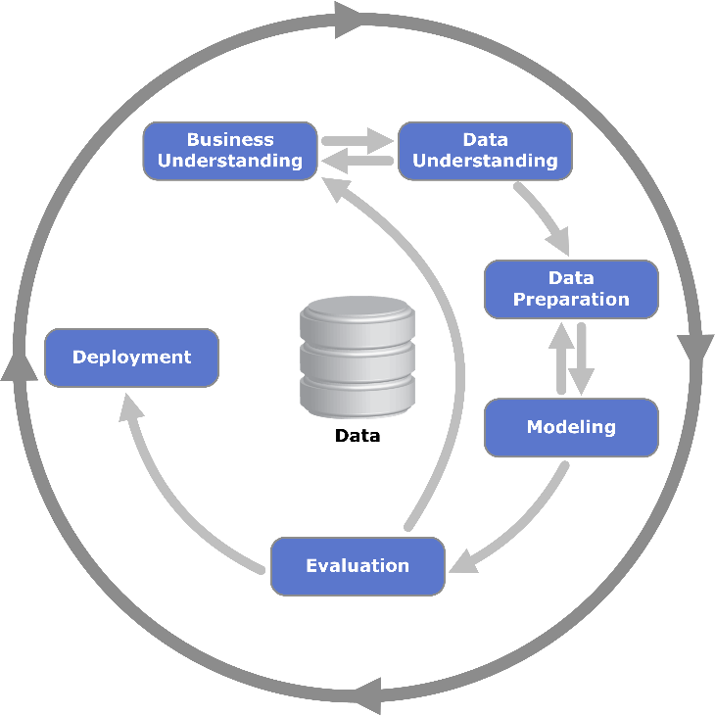
Methodology – CRISP-DM
Data collection, data properties, and data quality
Understanding the project goals and requirements from a business perspective
All activities up to the creation of the final data set
Application of various modelling techniques
Performance of the models in relation to the business objectives are assessed

Slide 5
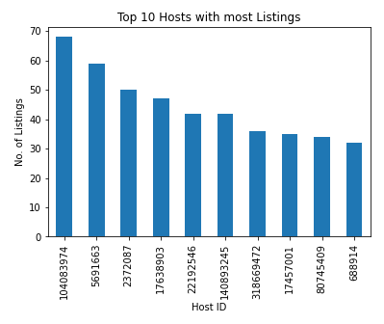
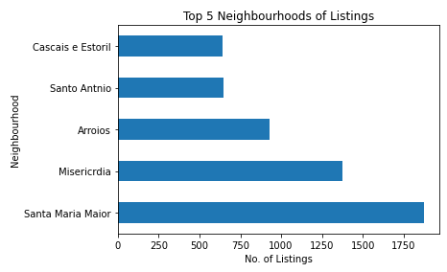
General Descriptive Statistics

Slide 6
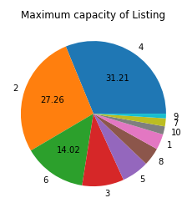
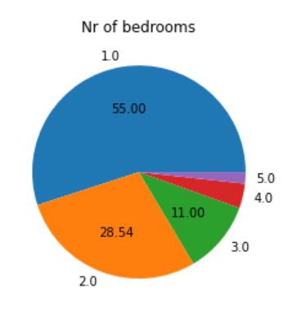
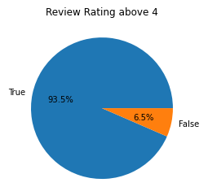
General Descriptive Statistics

Slide 7
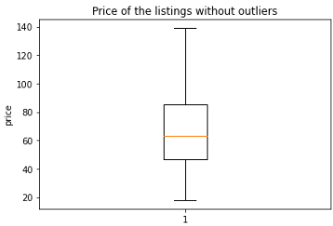
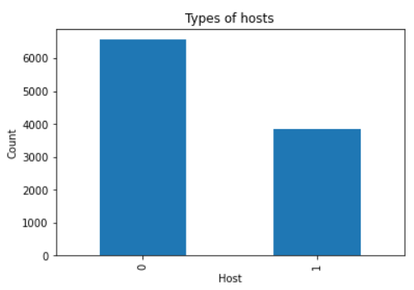
General Descriptive Statistics

Slide 8
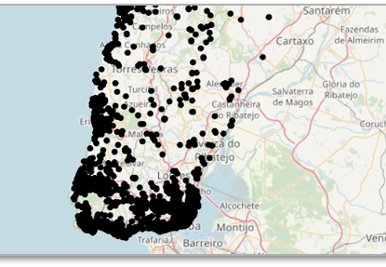
Geospatial Analysis
Method:
- Folium to create Leaflet maps
OpenStreetMap as geographic
database

Slide 9

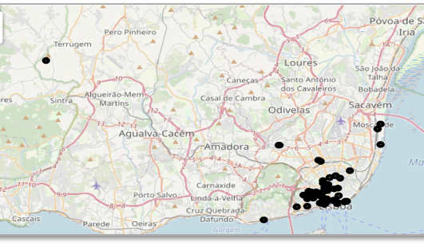
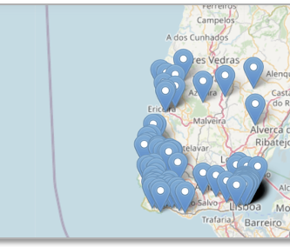
Geospatial Analysis
Housings belonging to the host
with the highest number of apartments
offered on Airbnb.
1% of the most expensive
Airbnb apartments

Slide 10
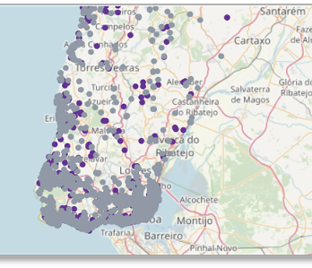
Hypothesis Testing
Superhosts
Regular Hosts
H1: The rental prices of apartments
belonging to a Superhost are higher
than the apartments belonging to a
regular host.
µ1 > µ2
Mann-Whitney-U Test: p-value=7.9342e-13

Slide 11
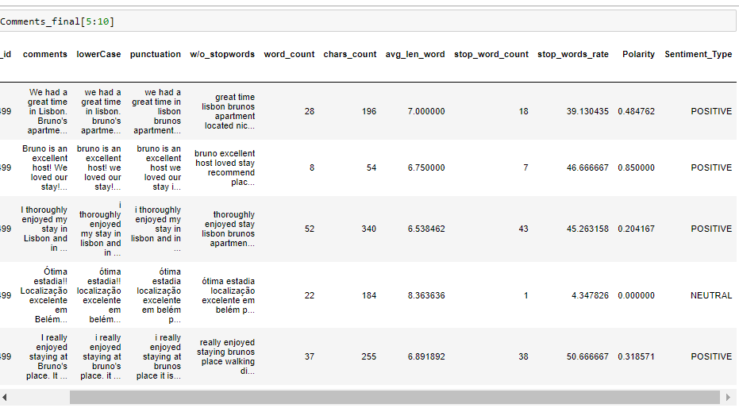
Sentiment Analysis
Clean the coments
Extract value from the reviews
Create a new feature to add to our models

Slide 12
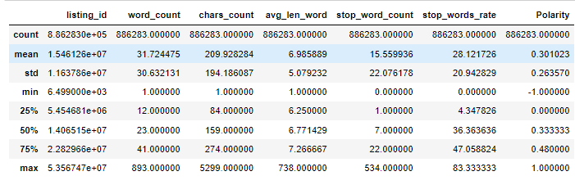
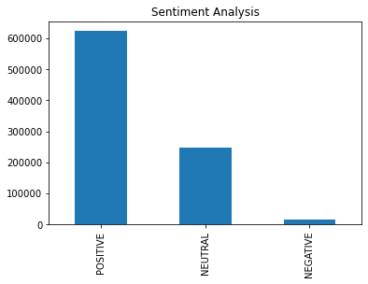
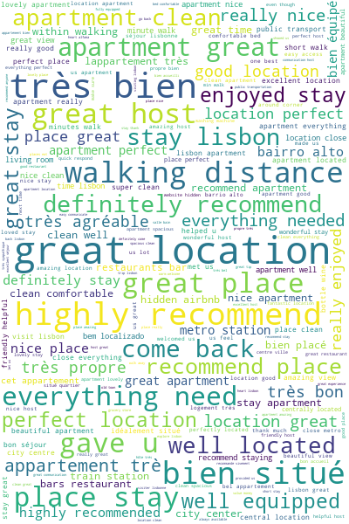
Overall, grouped by and single analysis perspective
Most of the comments tend to be positive
Most common words match the positive comments

Slide 13
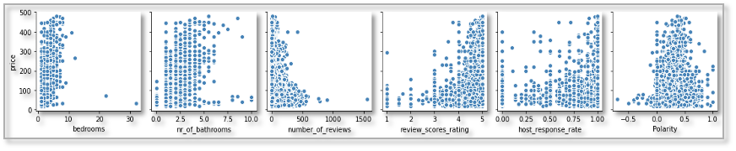
Multivariate Linear Regression
- "Price" - dependent Variable (Y)
- Forward selection method for the independent variables
- Outliers were removed ( 3 standard deviations above/below the mean)

Slide 14
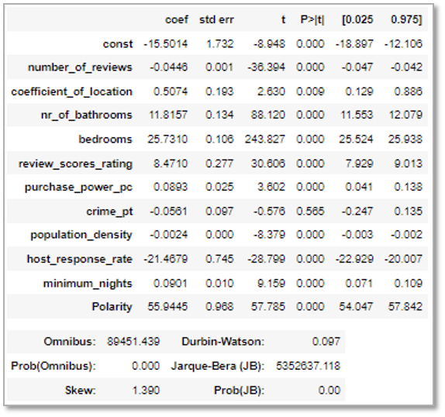
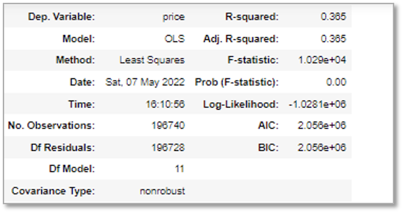
Multivariate Linear Regression

Slide 15
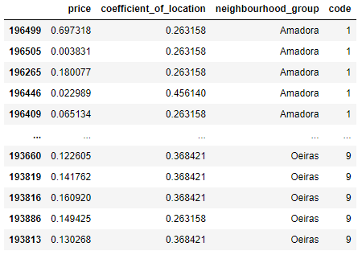
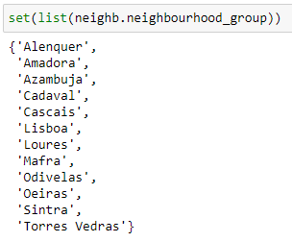
Clustering – Data Frame

Slide 16
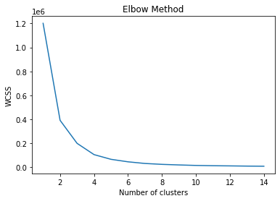
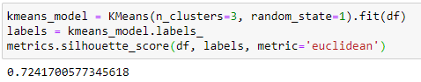
Clustering – Elbow Method

Slide 17
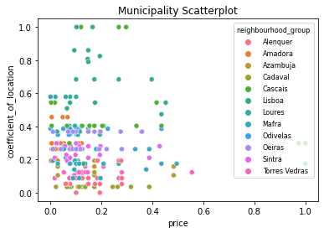
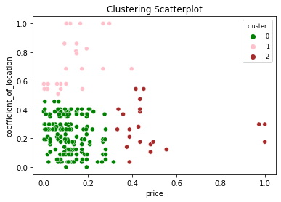
Clustering – Visualization

Slide 18
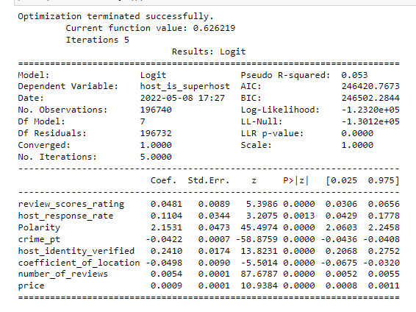
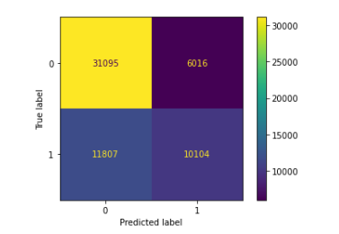
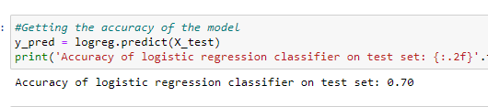
Classification – Logistic regression
….Superhosts clearly have a positive impact on clients view
Low R2
Gives important information about the features
Requires backup of other classification models

Slide 19
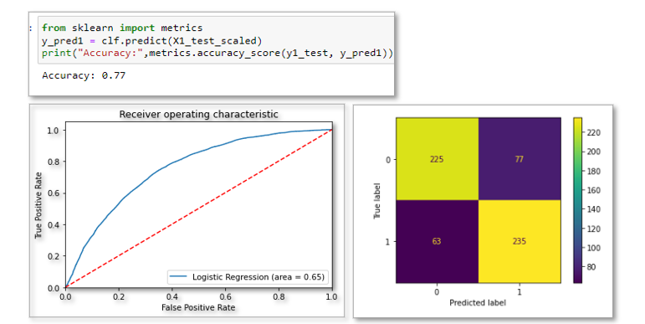
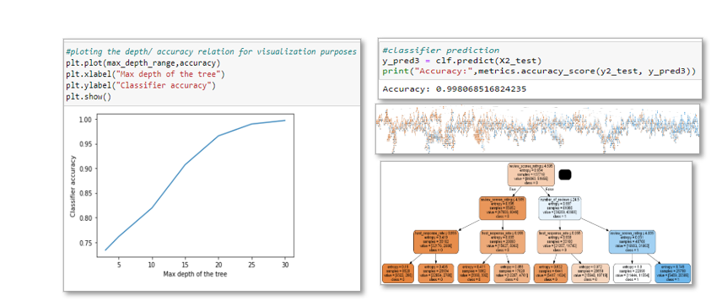
Classification – SVM and Classification Tree

Slide 20

Conclusion
Superhost Status influences accommodation attractiveness
Higher number of bedrooms, review scores, as well as review polarity often correlate with higher accommodation pricing
Listings in municipalities with lower coefficients of location do not necessarily correspond to lower pricings

Slide 21

Questions?

